Slide 1
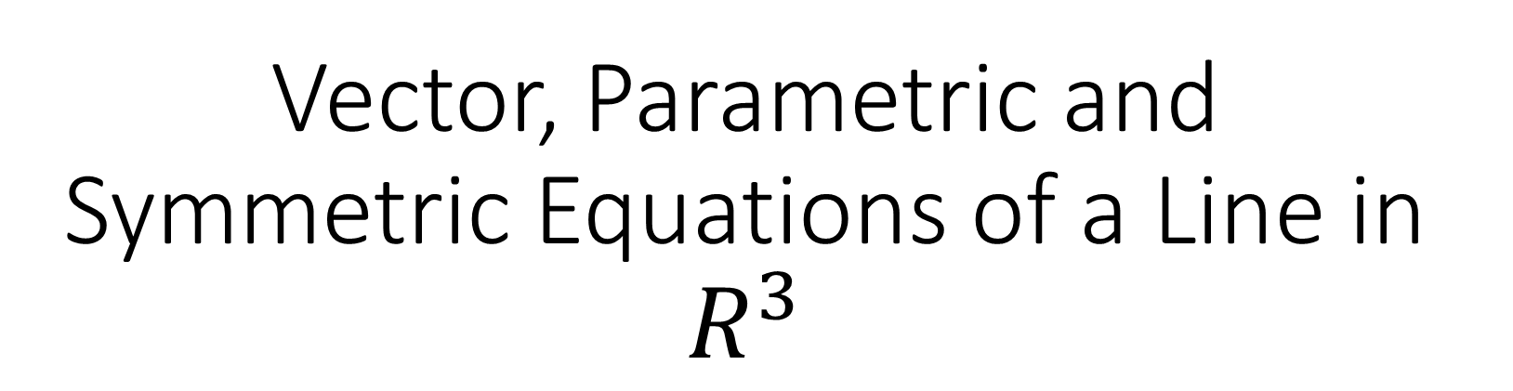
Vector, Parametric and Symmetric Equations of a Line in $R^{3}$

Slide 2
Example
Determine the vector equation and parametric equations of a line that passes through the points A(2,-3,4) and B(8,1,-9)

Slide 3
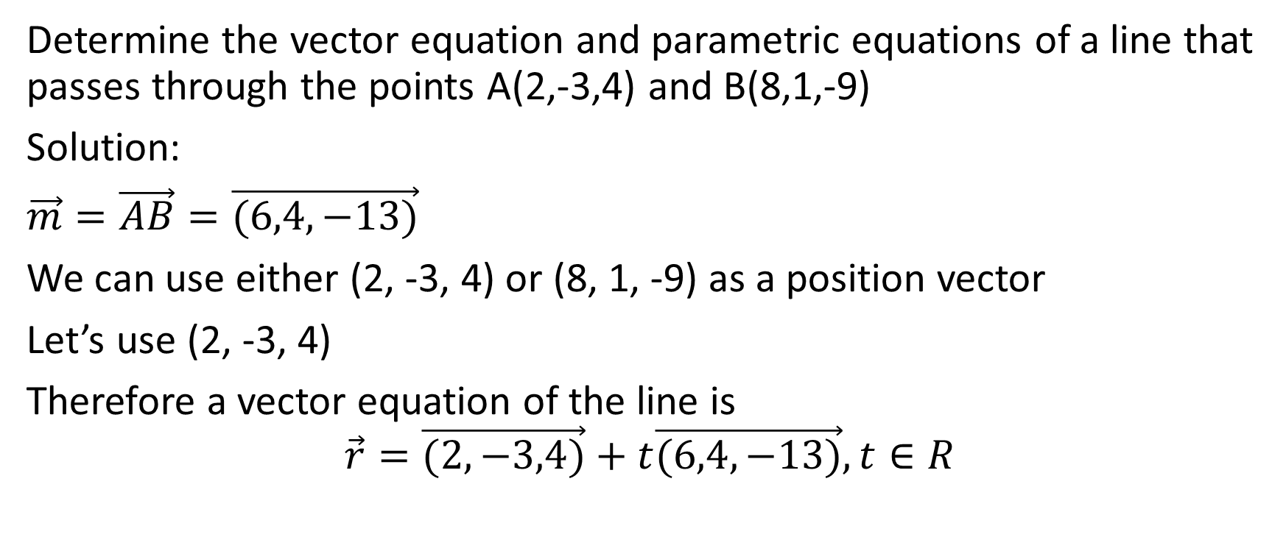
Determine the vector equation and parametric equations of a line that passes through the points A(2,-3,4) and B(8,1,-9)
Solution:
$\vec{m}=\vec{AB}=\vec{(6,4,−13)}$
We can use either (2, -3, 4) or (8, 1, -9) as a position vector
Let’s use (2, -3, 4)
Therefore a vector equation of the line is
$$\vec{r}=\vec{(2,−3,4)}+t\vec{(6,4,−13)},t∈R$$

Slide 4

Determine the vector equation and parametric equations of a line that passes through the points A(2,-3,4) and B(8,1,-9)
Solution:
$$\vec{r}=\vec{(2,−3,4)}+t\vec{(6,4,−13)},t∈R$$

Slide 5
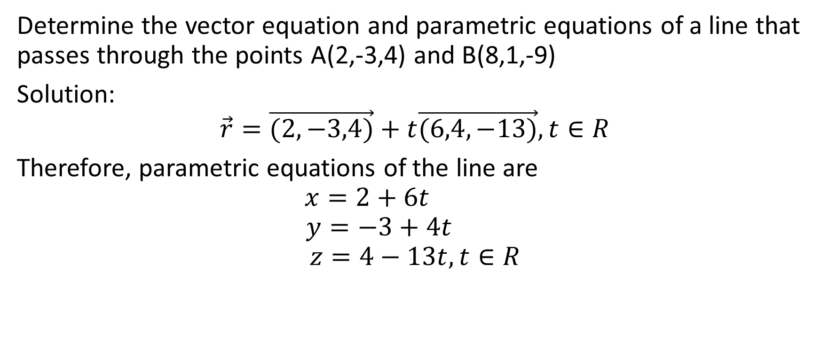
Determine the vector equation and parametric equations of a line that passes through the points A(2,-3,4) and B(8,1,-9)
Solution:
$$\vec{r}=\vec{(2,−3,4)}+t\vec{(6,4,−13)},t∈R$$
Therefore, parametric equations of the line are
$$x=2+6t$$
$$y=−3+4t$$
$$z=4−13t, t∈R$$

Slide 6

Example:
Show that the following two vector equations represent the same line
$$L_{1}:\vec{r}=\vec{(3,1,0)}+s\vec{(−9,6,3)},s∈R$$
$$L_{2}:\vec{r}=\vec{(−6,7,3)}+t\vec{(3,−2,−1)},t∈R$$

Slide 7
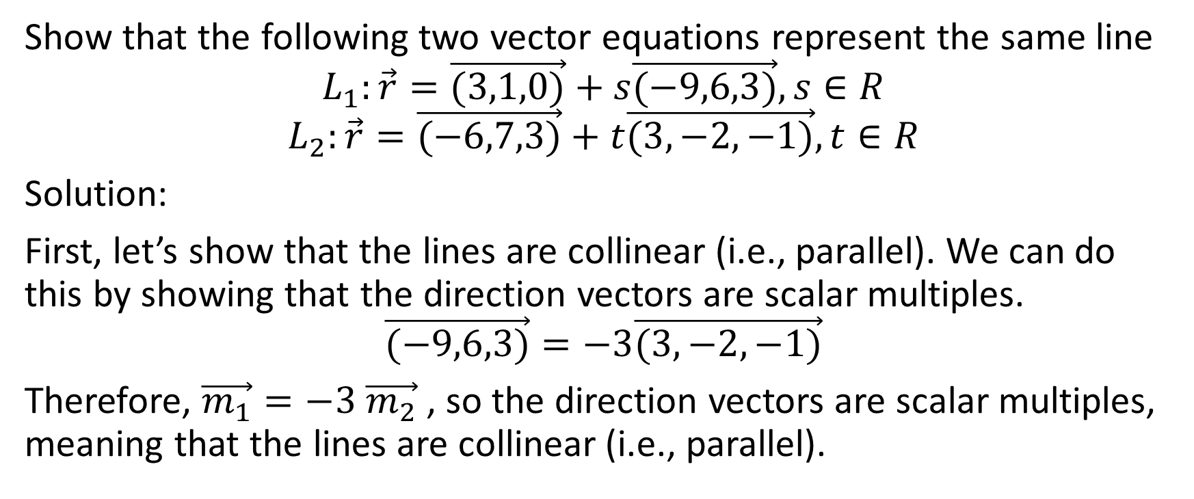
Show that the following two vector equations represent the same line
$$L_{1}:\vec{r}=\vec{(3,1,0)}+s\vec{(−9,6,3)},s∈R$$
$$L_{2}:\vec{r}=\vec{(−6,7,3)}+t\vec{(3,−2,−1)},t∈R$$
Solution:
First, let’s show that the lines are collinear (i.e., parallel). We can do this by showing that the direction vectors are scalar multiples.
$$\vec{(−9,6,3)}=−3\vec{(3,−2,−1)}$$
Therefore, $\vec{m_{1}}=−3 \vec{m_{2}}$ , so the direction vectors are scalar multiples, meaning that the lines are collinear (i.e., parallel).

Slide 8
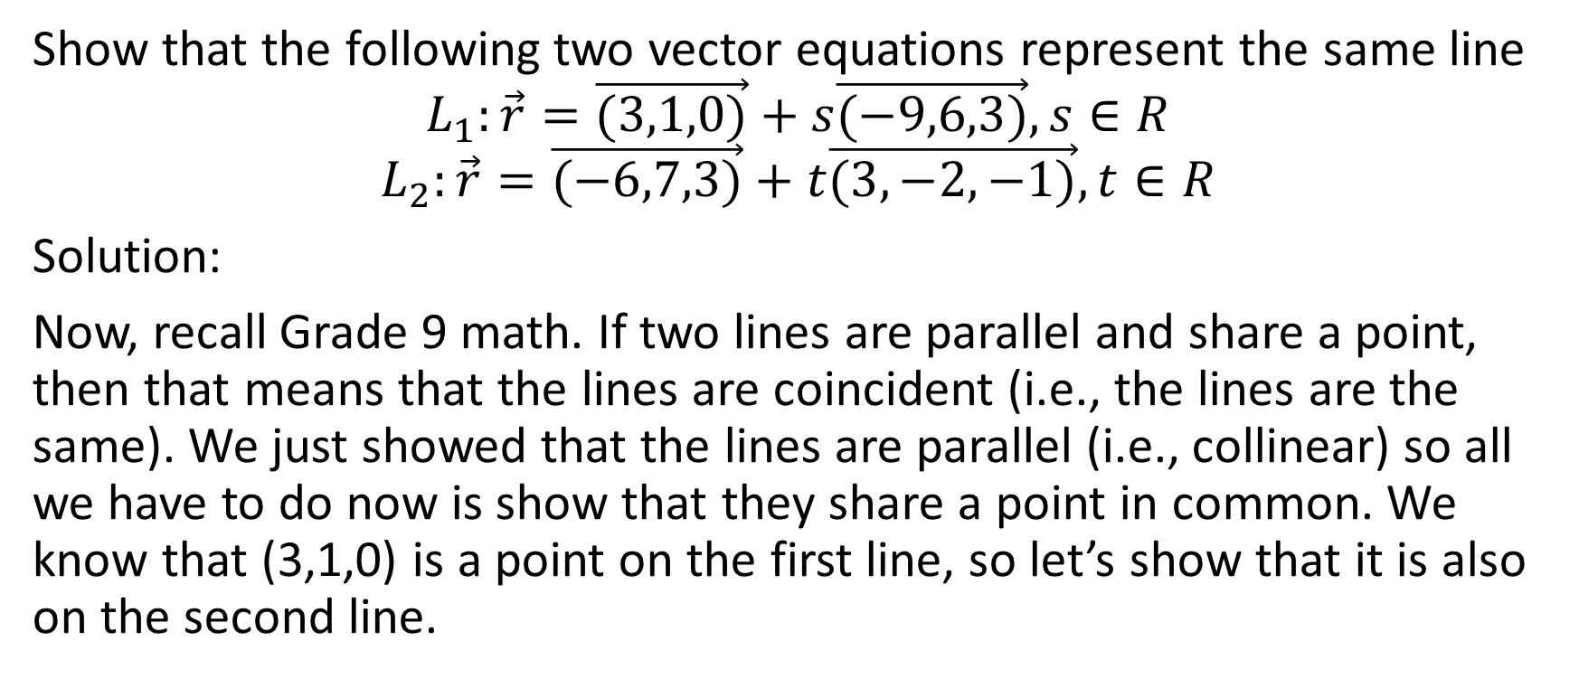
Show that the following two vector equations represent the same line
$$L_{1}:\vec{r}=\vec{(3,1,0)}+s\vec{(−9,6,3)},s∈R$$
$$L_{2}:\vec{r}=\vec{(−6,7,3)}+t\vec{(3,−2,−1)},t∈R$$
Solution:
Now, recall Grade 9 math. If two lines are parallel and share a point, then that means that the lines are coincident (i.e., the lines are the same). We just showed that the lines are parallel (i.e., collinear) so all we have to do now is show that they share a point in common. We know that (3,1,0) is a point on the first line, so let’s show that it is also on the second line.

Slide 9
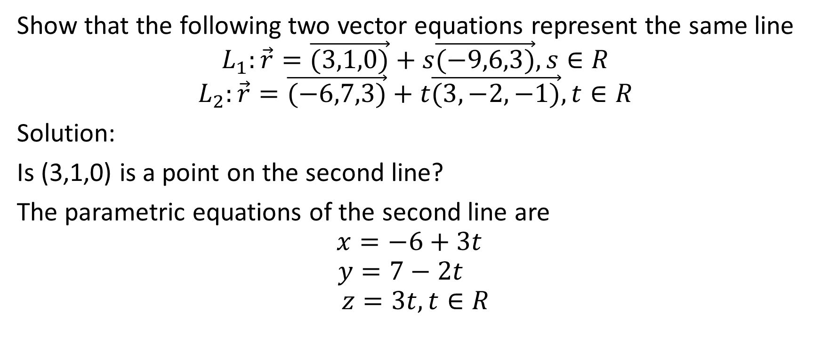
Show that the following two vector equations represent the same line
$$L_{1}:\vec{r}=\vec{(3,1,0)}+s\vec{(−9,6,3)},s∈R$$
$$L_{2}:\vec{r}=\vec{(−6,7,3)}+t\vec{(3,−2,−1)},t∈R$$
Solution:
Is (3,1,0) is a point on the second line?
The parametric equations of the second line are
$$x=−6+3t$$
$$y=7−2t$$
$$z=3t,t∈R$$

Slide 10
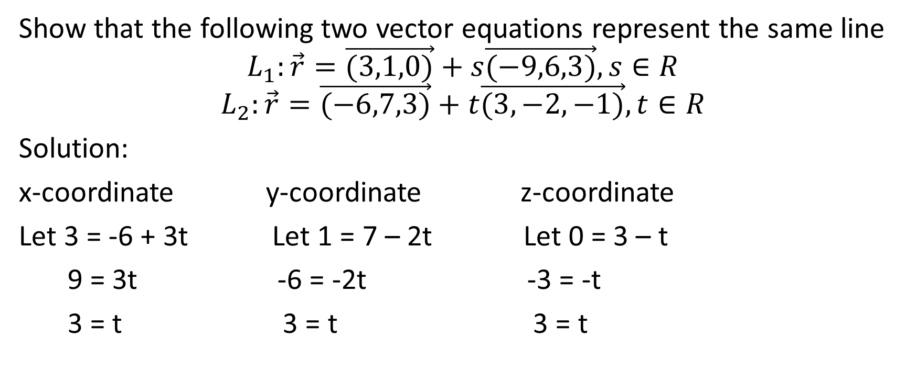
Show that the following two vector equations represent the same line
$$L_{1}:\vec{r}=\vec{(3,1,0)}+s\vec{(−9,6,3)},s∈R$$
$$L_{2}:\vec{r}=\vec{(−6,7,3)}+t\vec{(3,−2,−1)},t∈R$$
Solution:
x-coordinate y-coordinate z-coordinate
Let 3 = -6 + 3t Let 1 = 7 – 2t Let 0 = 3 – t
9 = 3t -6 = -2t -3 = -t
3 = t 3 = t 3 = t

Slide 11
Show that the following two vector equations represent the same line
$$L_{1}:\vec{r}=\vec{(3,1,0)}+s\vec{(−9,6,3)},s∈R$$
$$L_{2}:\vec{r}=\vec{(−6,7,3)}+t\vec{(3,−2,−1)},t∈R$$
Solution:
x-coordinate y-coordinate z-coordinate
Let 3 = -6 + 3t Let 1 = 7 – 2t Let 0 = 3 – t
9 = 3t -6 = -2t -3 = -t
3 = t 3 = t 3 = t
Since t = 3 for all three coordinates, therefore, (3,1,0) is on the second line

Slide 12
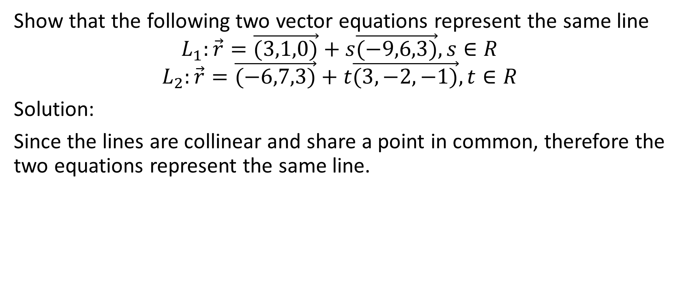
Show that the following two vector equations represent the same line
$$L_{1}:\vec{r}=\vec{(3,1,0)}+s\vec{(−9,6,3)},s∈R$$
$$L_{2}:\vec{r}=\vec{(−6,7,3)}+t\vec{(3,−2,−1)},t∈R$$
Solution:
Since the lines are collinear and share a point in common, therefore the two equations represent the same line.

Slide 13
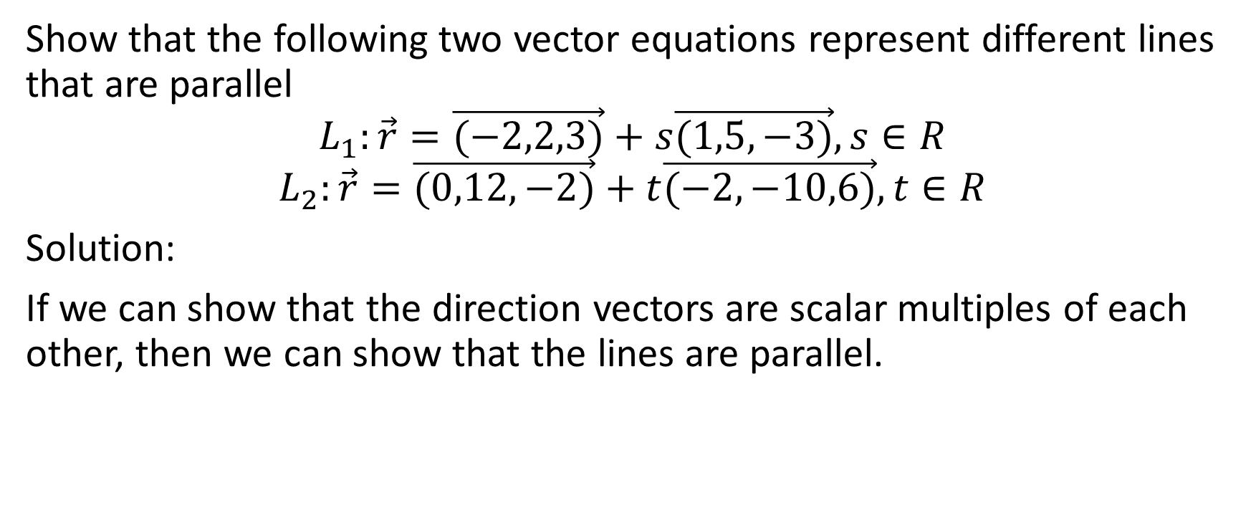
Example
Show that the following two vector equations represent different lines that are parallel
$$L_{1}:\vec{r}=\vec{(−2,2,3)}+s\vec{(1,5,−3)},s∈R$$
$$L_{2}:\vec{r}=\vec{(0,12,−2)}+t\vec{(−2,−10,6)},t∈R$$
Solution:
If we can show that the direction vectors are scalar multiples of each other, then we can show that the lines are parallel.

Slide 14
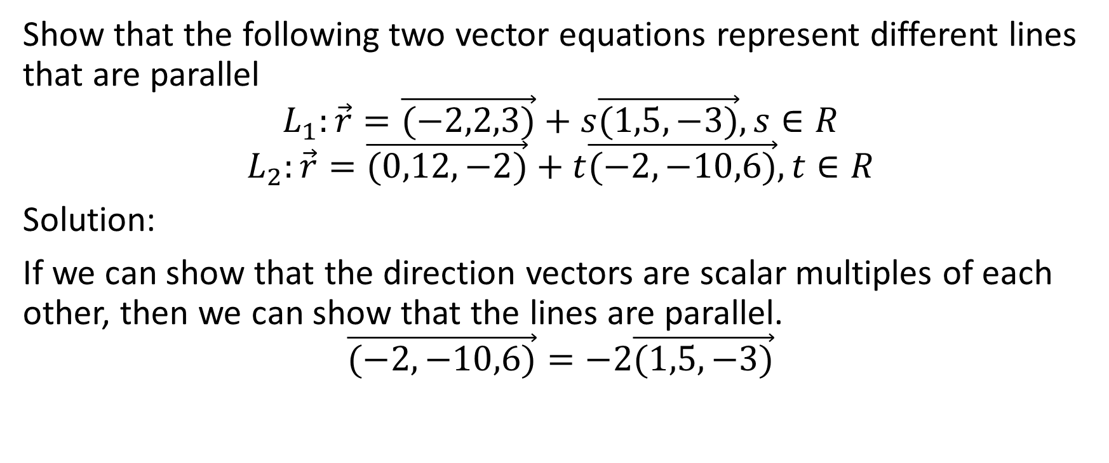
Show that the following two vector equations represent different lines that are parallel
$$L_{1}:\vec{r}=\vec{(−2,2,3)}+s\vec{(1,5,−3)},s∈R$$
$$L_{2}:\vec{r}=\vec{(0,12,−2)}+t\vec{(−2,−10,6)},t∈R$$
Solution:
If we can show that the direction vectors are scalar multiples of each other, then we can show that the lines are parallel.
$$\vec{(−2,−10,6)}=−2\vec{(1,5,−3)}$$

Slide 15
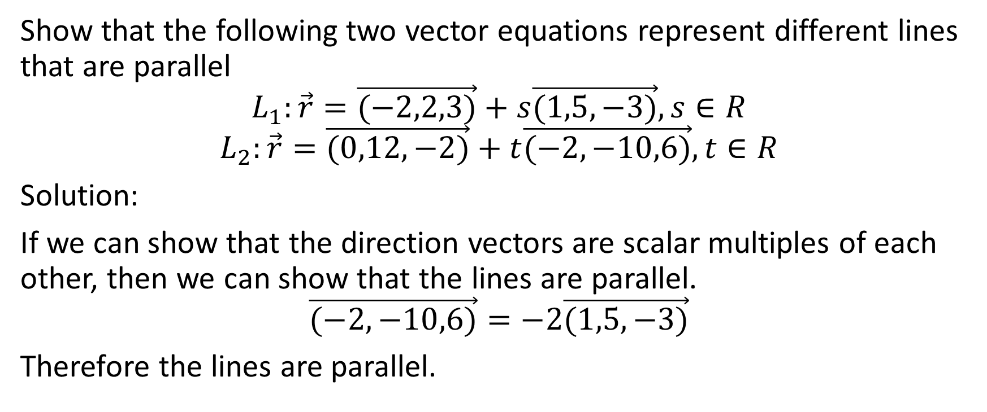
Show that the following two vector equations represent different lines that are parallel
$$L_{1}:\vec{r}=\vec{(−2,2,3)}+s\vec{(1,5,−3)},s∈R$$
$$L_{2}:\vec{r}=\vec{(0,12,−2)}+t\vec{(−2,−10,6)},t∈R$$
Solution:
If we can show that the direction vectors are scalar multiples of each other, then we can show that the lines are parallel.
$$\vec{(−2,−10,6)}=−2\vec{(1,5,−3)}$$
Therefore the lines are parallel.

Slide 16
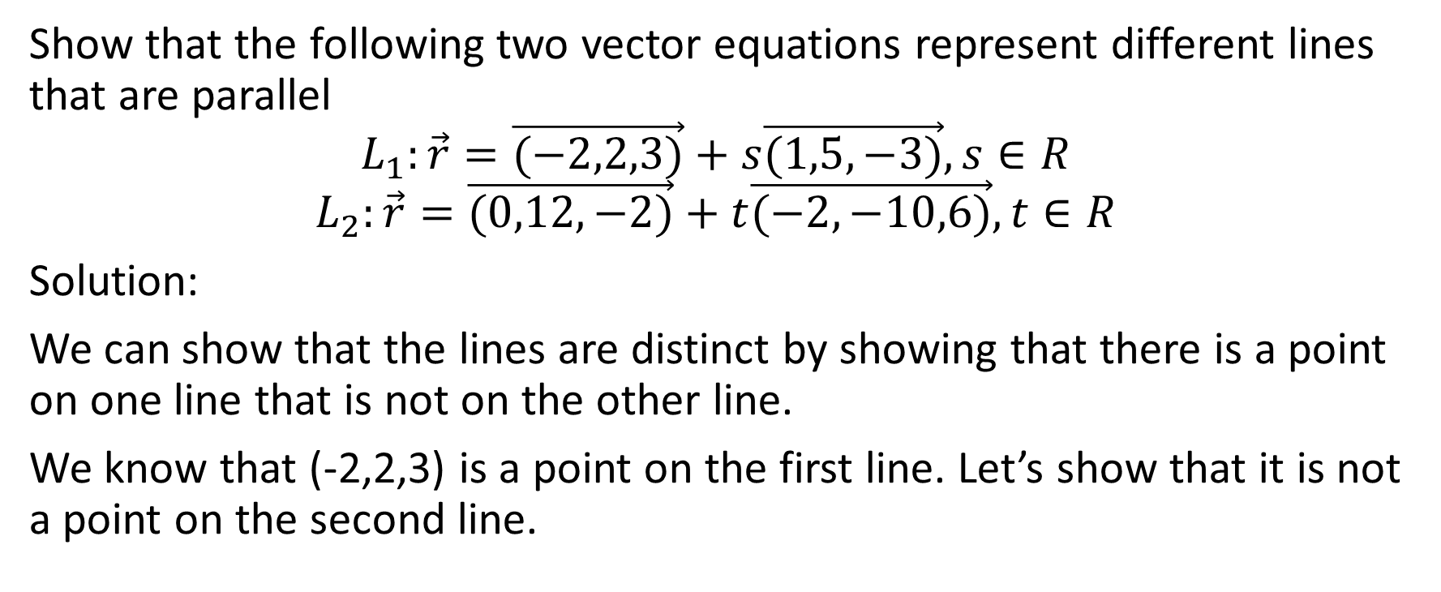
Show that the following two vector equations represent different lines that are parallel
$$L_{1}:\vec{r}=\vec{(−2,2,3)}+s\vec{(1,5,−3)},s∈R$$
$$L_{2}:\vec{r}=\vec{(0,12,−2)}+t\vec{(−2,−10,6)},t∈R$$
Solution:
We can show that the lines are distinct by showing that there is a point on one line that is not on the other line.
We know that (-2,2,3) is a point on the first line. Let’s show that it is not a point on the second line.

Slide 17
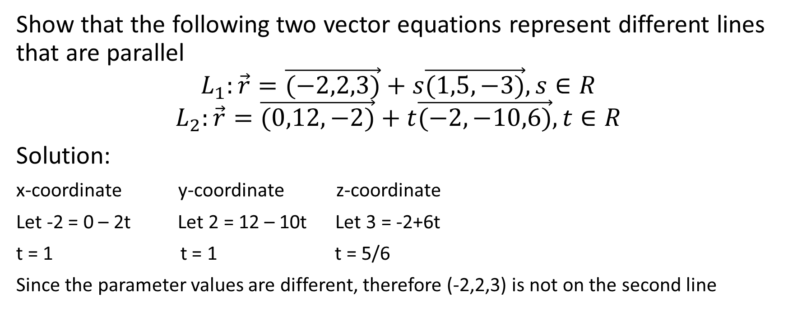
Show that the following two vector equations represent different lines that are parallel
$$L_{1}:\vec{r}=\vec{(−2,2,3)}+s\vec{(1,5,−3)},s∈R$$
$$L_{2}:\vec{r}=\vec{(0,12,−2)}+t\vec{(−2,−10,6)},t∈R$$
Solution:
x-coordinate y-coordinate z-coordinate
Let -2 = 0 – 2t Let 2 = 12 – 10t Let 3 = -2+6t
t = 1 t = 1 t = 5/6
Since the parameter values are different, therefore (-2,2,3) is not on the second line

Slide 18

Show that the following two vector equations represent different lines that are parallel
$$L_{1}:\vec{r}=\vec{(−2,2,3)}+s\vec{(1,5,−3)},s∈R$$
$$L_{2}:\vec{r}=\vec{(0,12,−2)}+t\vec{(−2,−10,6)},t∈R$$
Solution:
x-coordinate y-coordinate z-coordinate
Let -2 = 0 – 2t Let 2 = 12 – 10t Let 3 = -2+6t
t = 1 t = 1 t = 5/6
Since the parameter values are different, therefore (-2,2,3) is not on the second line
Therefore the lines are parallel but they are not the same line

Slide 19

Example
Does the line $\vec{r}=\vec{(8,4,−1)}+t\vec{(4,1,3)},t∈R$ have a z-intercept?

Slide 20

Does the line $\vec{r}=\vec{(8,4,−1)}+t\vec{(4,1,3)},t∈R$ have a z-intercept?
Solutions: A z-intercept would be the point at which the line intersects the z-axis. This would be the point at which x = 0 and y = 0.

Slide 21
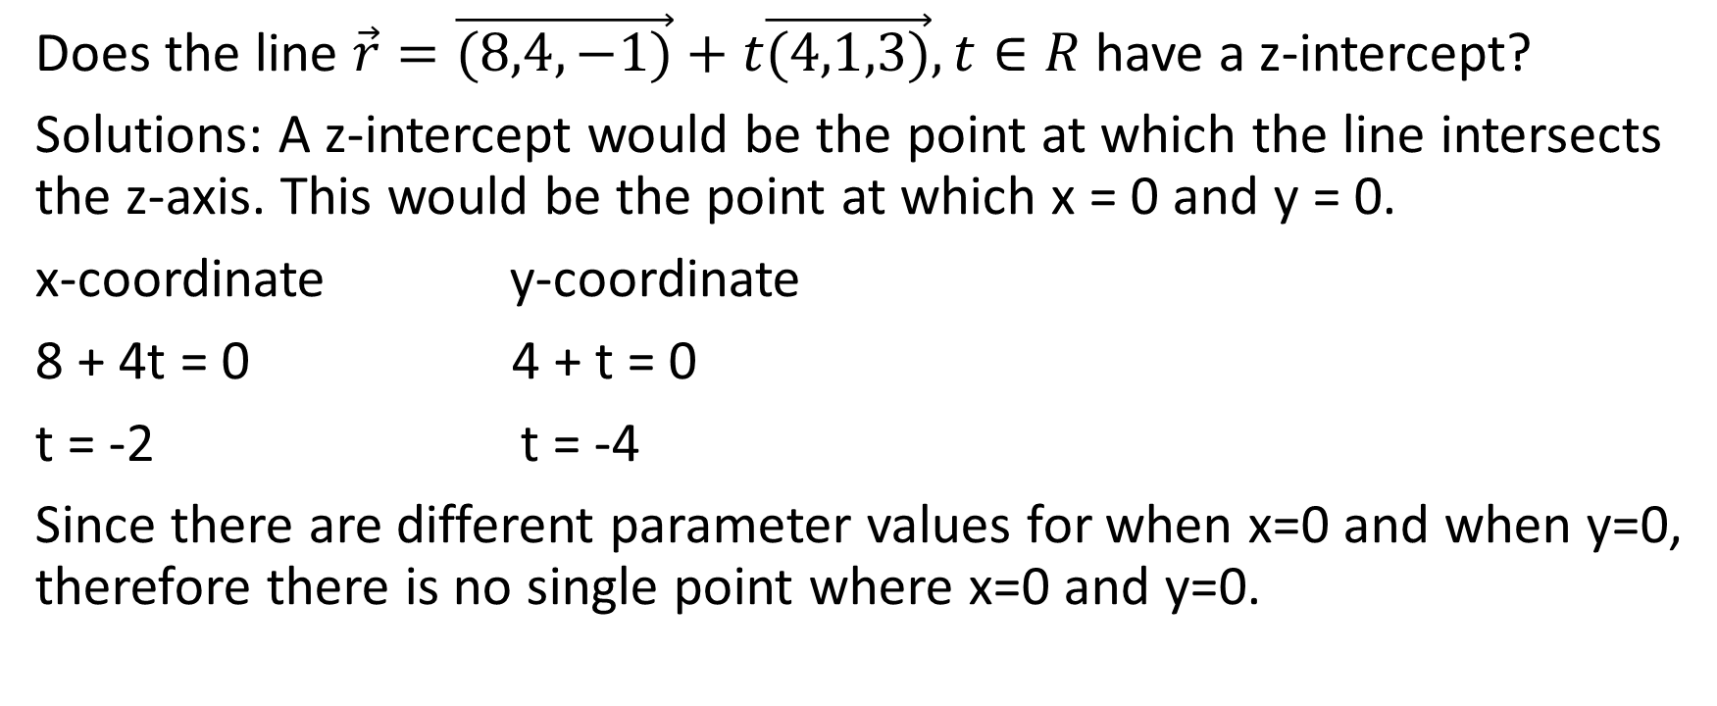
Does the line $\vec{r}=\vec{(8,4,−1)}+t\vec{(4,1,3)},t∈R$ have a z-intercept?
Solutions: A z-intercept would be the point at which the line intersects the z-axis. This would be the point at which x = 0 and y = 0.
x-coordinate y-coordinate
8 + 4t = 0 4 + t = 0
t = -2 t = -4
Since there are different parameter values for when x=0 and when y=0, therefore there is no single point where x=0 and y=0.
Therefore, there is no z-intercept

Slide 22

Example
Determine the y-intercept of the line $\vec{r}=\vec{(6,5,−4)}+t\vec{(−3,−1,2)},t∈R$

Slide 23
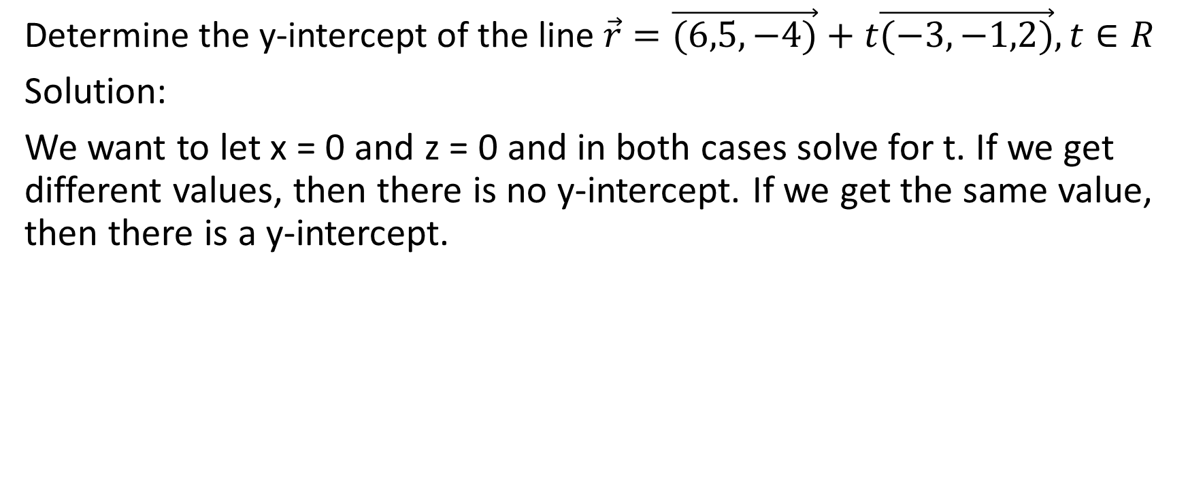
Determine the y-intercept of the line $\vec{r}=\vec{(6,5,−4)}+t\vec{(−3,−1,2)},t∈R$
Solution:
We want to let x = 0 and z = 0 and in both cases solve for t. If we get different values, then there is no y-intercept. If we get the same value, then there is a y-intercept.

Slide 24
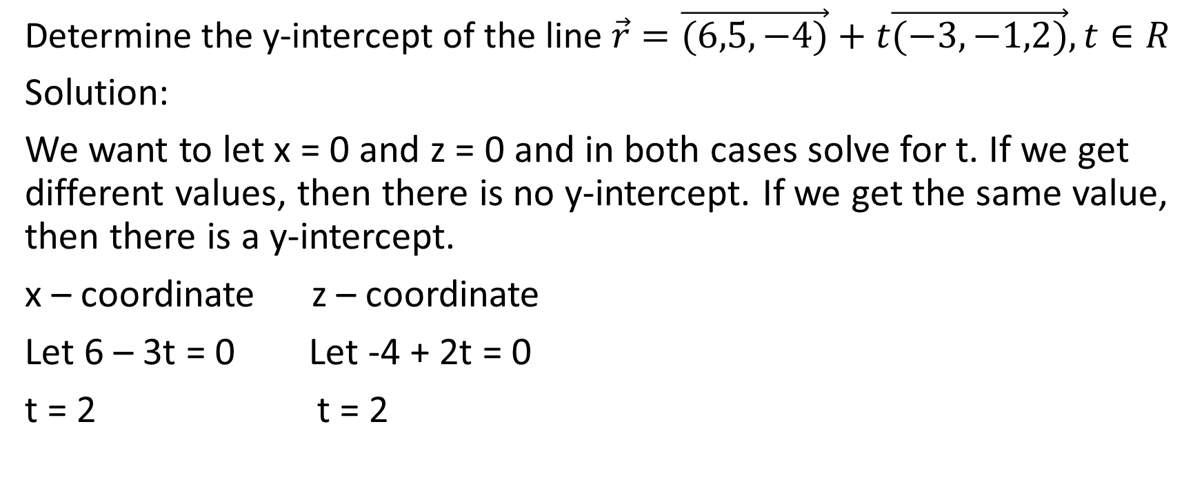
Determine the y-intercept of the line $\vec{r}=\vec{(6,5,−4)}+t\vec{(−3,−1,2)},t∈R$
Solution:
We want to let x = 0 and z = 0 and in both cases solve for t. If we get different values, then there is no y-intercept. If we get the same value, then there is a y-intercept.
x – coordinate z – coordinate
Let 6 – 3t = 0 Let -4 + 2t = 0
t = 2 t = 2

Slide 25
Determine the y-intercept of the line $\vec{r}=\vec{(6,5,−4)}+t\vec{(−3,−1,2)},t∈R$
Solution:
We want to let x = 0 and z = 0 and in both cases solve for t. If we get different values, then there is no y-intercept. If we get the same value, then there is a y-intercept.
x – coordinate z – coordinate
Let 6 – 3t = 0 Let -4 + 2t = 0
t = 2 t = 2
Therefore, we have a y – intercept at the point where t = 2

Slide 26
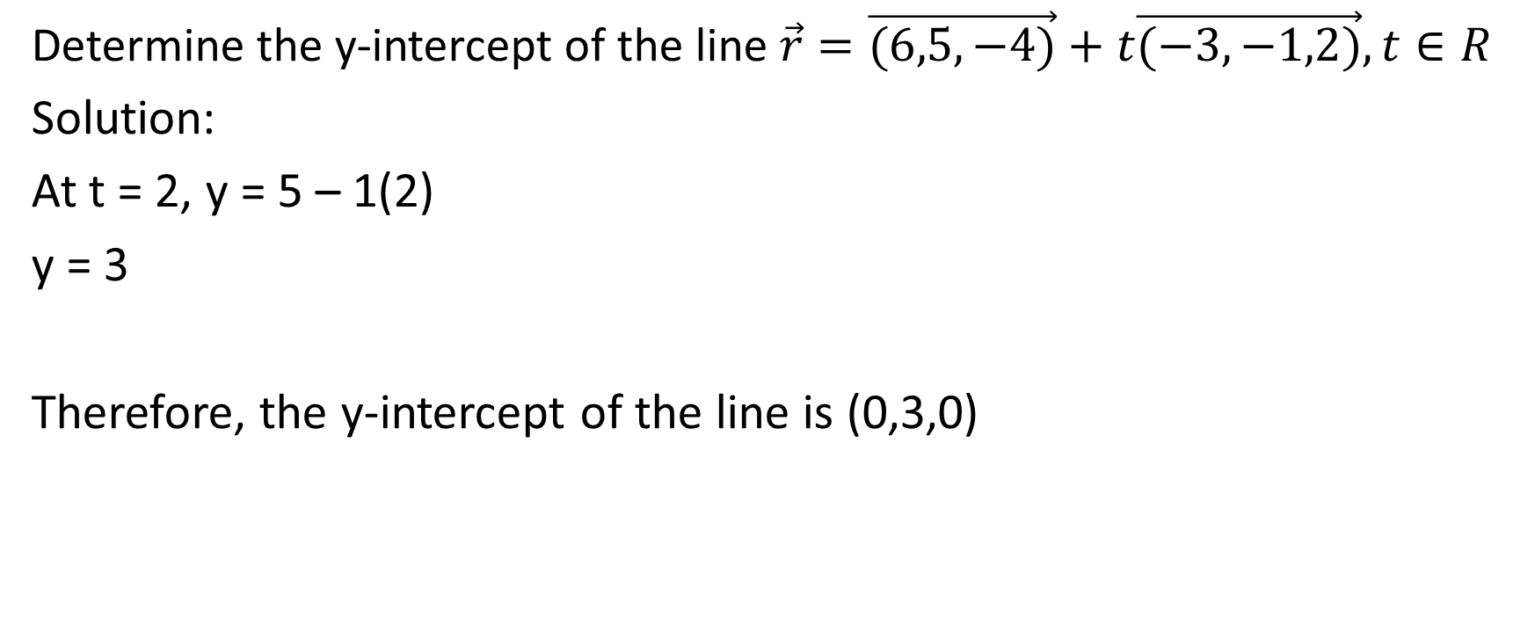
Determine the y-intercept of the line $\vec{r}=\vec{(6,5,−4)}+t\vec{(−3,−1,2)},t∈R$
Solution:
At t = 2, y = 5 – 1(2)
y = 3
Therefore, the y-intercept of the line is (0,3,0)

Slide 27

Symmetric Equation of a Line
Suppose $\vec{r}=\vec{\left(x_{o},y_{o},z_{o}\right)}+t\vec{(a,b,c)},t∈R$ is the equation of a line in $R^{3}$. Further, suppose that none of $a$ or $b$ or $c$ are zero (in other words, the components of the direction vector are all non-zero).

Slide 28
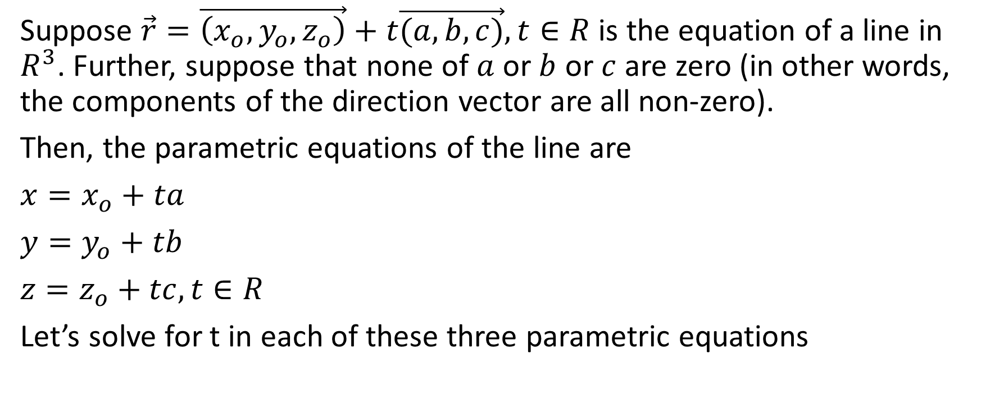
Suppose $\vec{r}=\vec{\left(x_{o},y_{o},z_{o}\right)}+t\vec{(a,b,c)},t∈R$ is the equation of a line in $R^{3}$. Further, suppose that none of $a$ or $b$ or $c$ are zero (in other words, the components of the direction vector are all non-zero).
Then, the parametric equations of the line are
$x=x_{o}+ta$
$y=y_{o}+tb$
$z=z_{o}+tc, t∈R$
Let’s solve for t in each of these three parametric equations

Slide 29
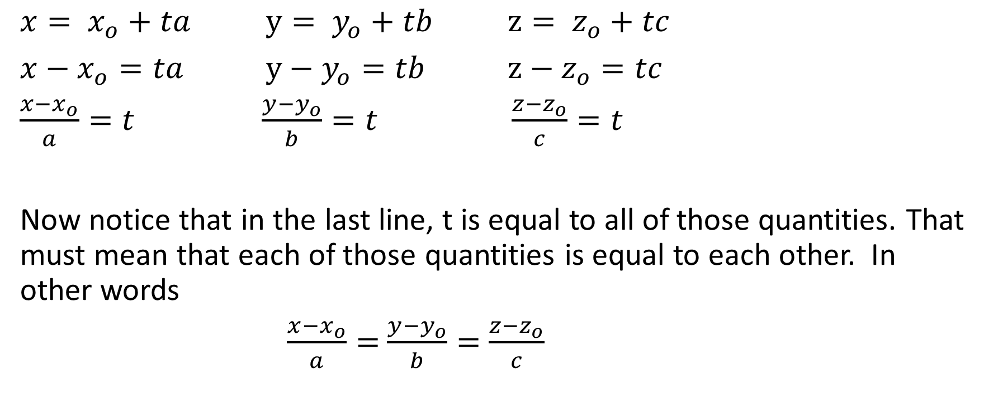
$x= x_{o}+ta$ $y= y_{o}+tb$ $z= z_{o}+tc$
$x−x_{o}=ta$ $y−y_{o}=tb$ $z−z_{o}=tc$
$\frac{x−x_{o}}{a}=t$ $\frac{y−y_{o}}{b}=t$ $\frac{z−z_{o}}{c}=t$
Now notice that in the last line, t is equal to all of those quantities. That must mean that each of those quantities is equal to each other. In other words
$\frac{x−x_{o}}{a}=$ $\frac{y−y_{o}}{b}=$ $\frac{z−z_{o}}{c}$

Slide 30
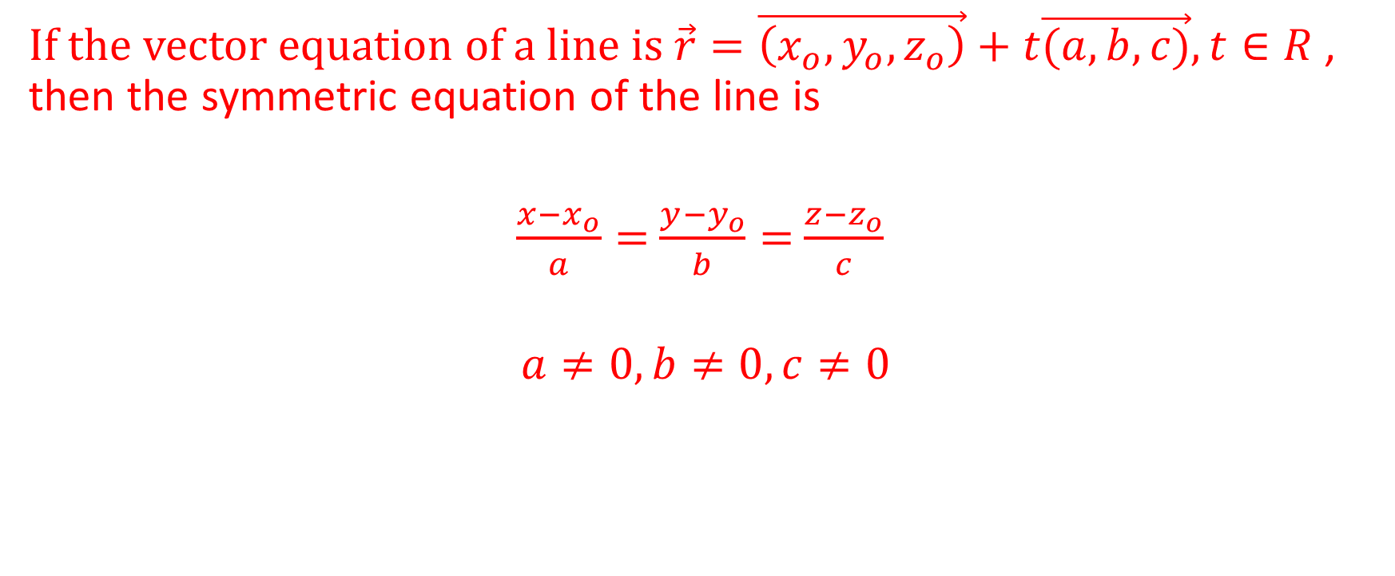
If the vector equation of a line is $\vec{r}=\vec{\left(x_{o},y_{o},z_{o}\right)}+t\vec{(a,b,c)},t∈R$ , then the symmetric equation of the line is
$\frac{x−x_{o}}{a}=$ $\frac{y−y_{o}}{b}=$ $\frac{z−z_{o}}{c}$
$$a≠0,b≠0,c≠0$$

Slide 31
Example
Determine the symmetric equation of the line that goes through the points A(2,5,3) and B(9,6,8)

Slide 32
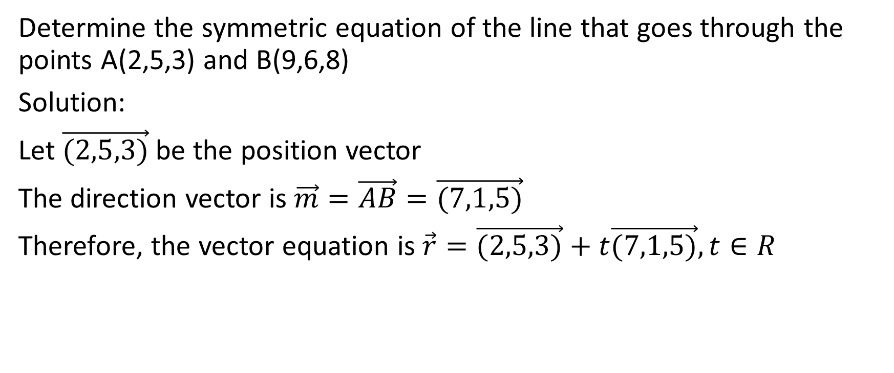
Determine the symmetric equation of the line that goes through the points A(2,5,3) and B(9,6,8)
Solution:
Let $\vec{(2,5,3)}$ be the position vector
The direction vector is $\vec{m}=\vec{AB}=\vec{(7,1,5)}$
Therefore, the vector equation is $\vec{r}=\vec{(2,5,3)}+t\vec{(7,1,5)},t∈R$

Slide 33

$\vec{r}=\vec{(2,5,3)}+t\vec{(7,1,5)},t∈R$

Slide 34

$\vec{r}=\vec{(2,5,3)}+t\vec{(7,1,5)},t∈R$
The symmetric equation of the line is
$\frac{x−2}{7}=\frac{y−5}{1}=\frac{z−3}{5}$
or more simply
$\frac{x−2}{7}=y−5=\frac{z−3}{5}$

Slide 35
Example
Determine the symmetric equation of the line that goes through the points C(3,6,2) and D(-2,6,1)

Slide 36
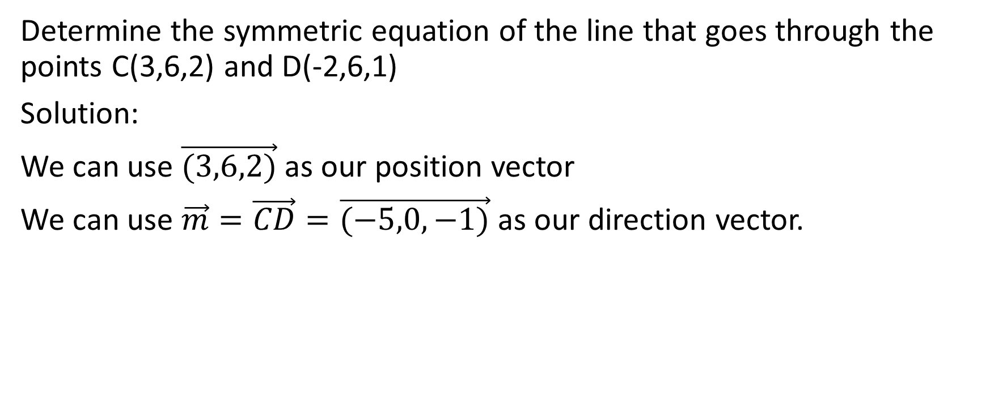
Determine the symmetric equation of the line that goes through the points C(3,6,2) and D(-2,6,1)
Solution:
We can use $\vec{(3,6,2)}$ as our position vector
We can use $\vec{m}=\vec{CD}=\vec{(−5,0,−1)}$ as our direction vector.

Slide 37
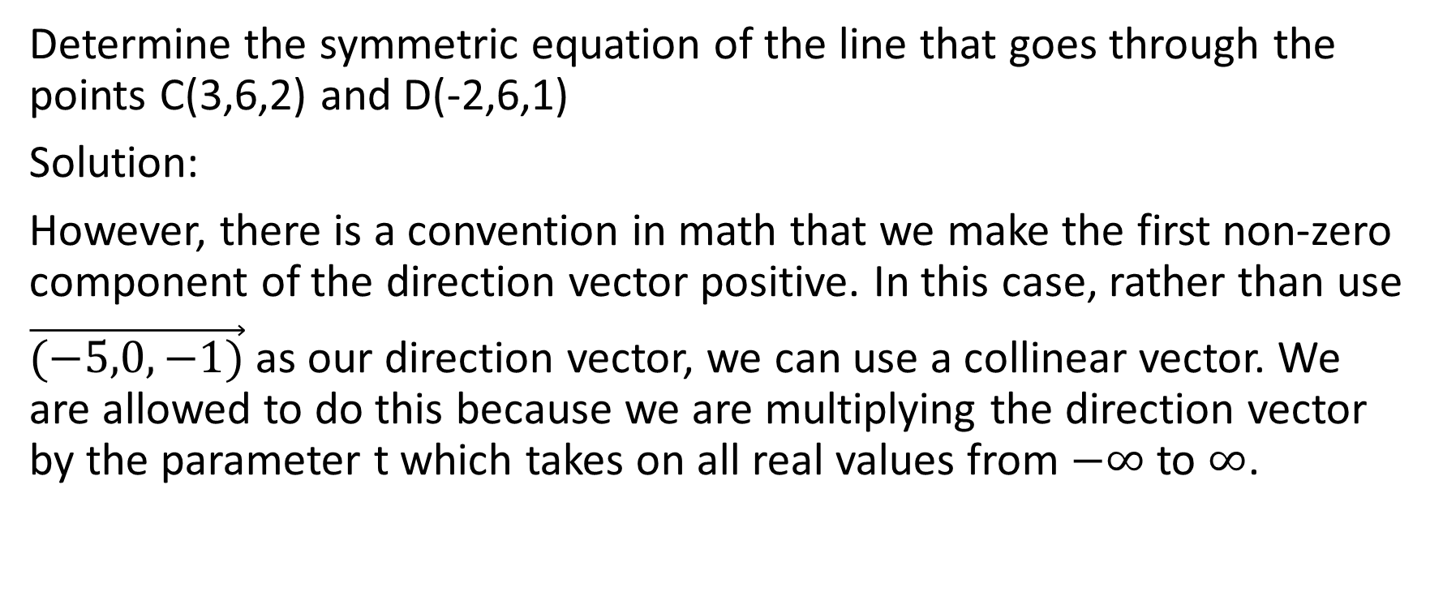
Determine the symmetric equation of the line that goes through the points C(3,6,2) and D(-2,6,1)
Solution:
However, there is a convention in math that we make the first non-zero component of the direction vector positive. In this case, rather than use
$\vec{(−5,0,−1)}$ as our direction vector, we can use a collinear vector. We are allowed to do this because we are multiplying the direction vector by the parameter t which takes on all real values from $−∞$ to $∞$.

Slide 38
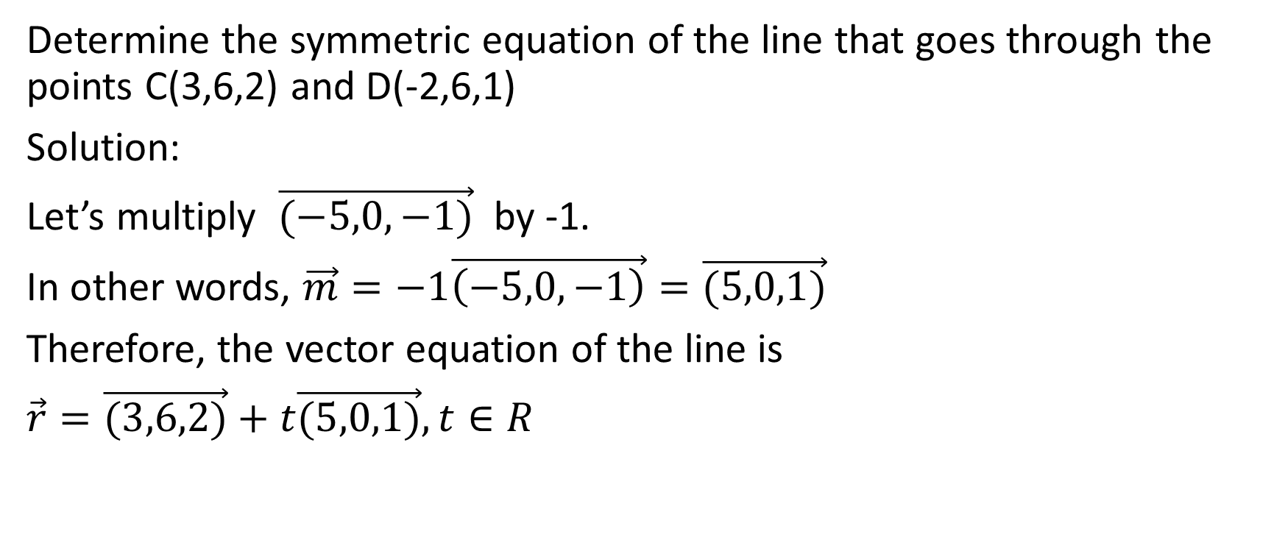
Determine the symmetric equation of the line that goes through the points C(3,6,2) and D(-2,6,1)
Solution:
Let’s multiply $\vec{(−5,0,−1)}$ by -1.
In other words, $\vec{m}=−1\vec{\left(−5,0,−1\right)}=\vec{(5,0,1)}$
Therefore, the vector equation of the line is
$\vec{r}=\vec{(3,6,2)}+t\vec{(5,0,1)},t∈R$

Slide 39

$\vec{r}=\vec{(3,6,2)}+t\vec{(5,0,1)},t∈R$

Slide 40
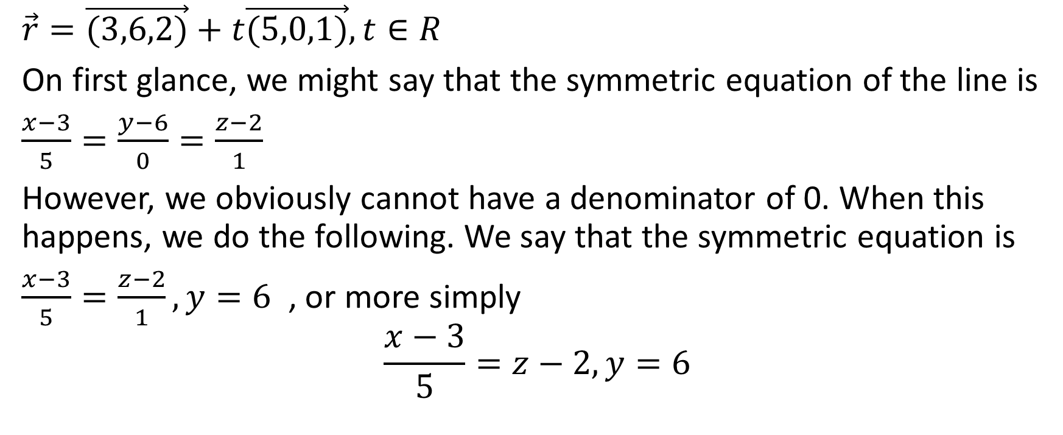
$\vec{r}=\vec{(3,6,2)}+t\vec{(5,0,1)},t∈R$
On first glance, we might say that the symmetric equation of the line is
$\frac{x−3}{5}=\frac{y−6}{0}=\frac{z−2}{1}$
However, we obviously cannot have a denominator of 0. When this happens, we do the following. We say that the symmetric equation is
$\frac{x−3}{5}=\frac{z−2}{1},y=6$ , or more simply
$$\frac{x−3}{5}=z−2,y=6$$

Slide 41

Example
State the vector equation of the line
$$\frac{x−4}{2}=\frac{y+7}{−2}=\frac{z−11}{5}$$

Slide 42

State the vector equation of the line
$$\frac{x−4}{2}=\frac{y+7}{−2}=\frac{z−11}{5}$$
Solution
$$\vec{r}=\vec{(4,−7,11)}+t\vec{(2,−2,5)},t∈R$$

Slide 43

Example
Determine the vector equation of the line
$$\frac{y+2}{3}=z,x=7$$

Slide 44
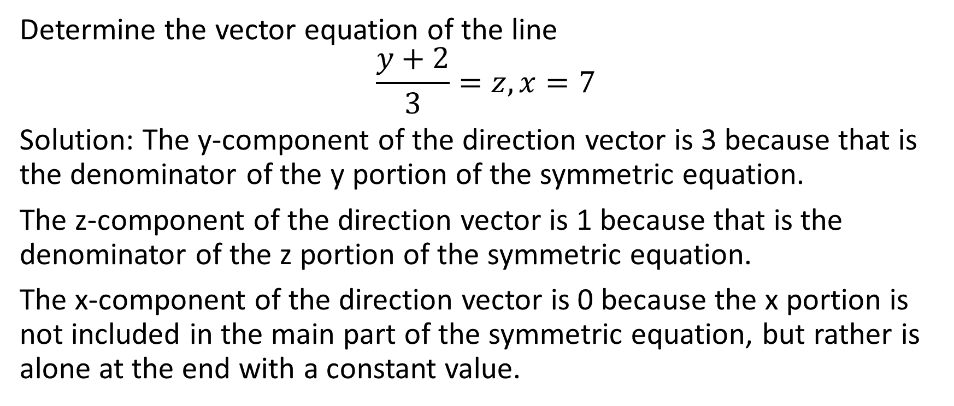
Determine the vector equation of the line
$$\frac{y+2}{3}=z,x=7$$
Solution: The y-component of the direction vector is 3 because that is the denominator of the y portion of the symmetric equation.
The z-component of the direction vector is 1 because that is the denominator of the z portion of the symmetric equation.
The x-component of the direction vector is 0 because the x portion is not included in the main part of the symmetric equation, but rather is alone at the end with a constant value.

Slide 45

Determine the vector equation of the line
$$\frac{y+2}{3}=z,x=7$$
Therefore, the direction vector is $\vec{(0,3,1)}$

Slide 46
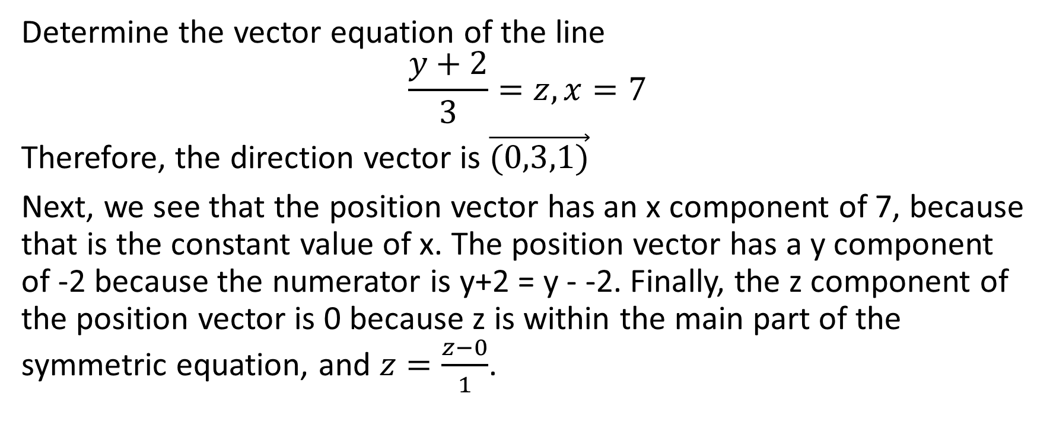
Determine the vector equation of the line
$$\frac{y+2}{3}=z,x=7$$
Therefore, the direction vector is $\vec{(0,3,1)}$
Next, we see that the position vector has an x component of 7, because that is the constant value of x. The position vector has a y component of -2 because the numerator is y+2 = y - -2. Finally, the z component of the position vector is 0 because z is within the main part of the symmetric equation, and $z=\frac{z−0}{1}$.

Slide 47
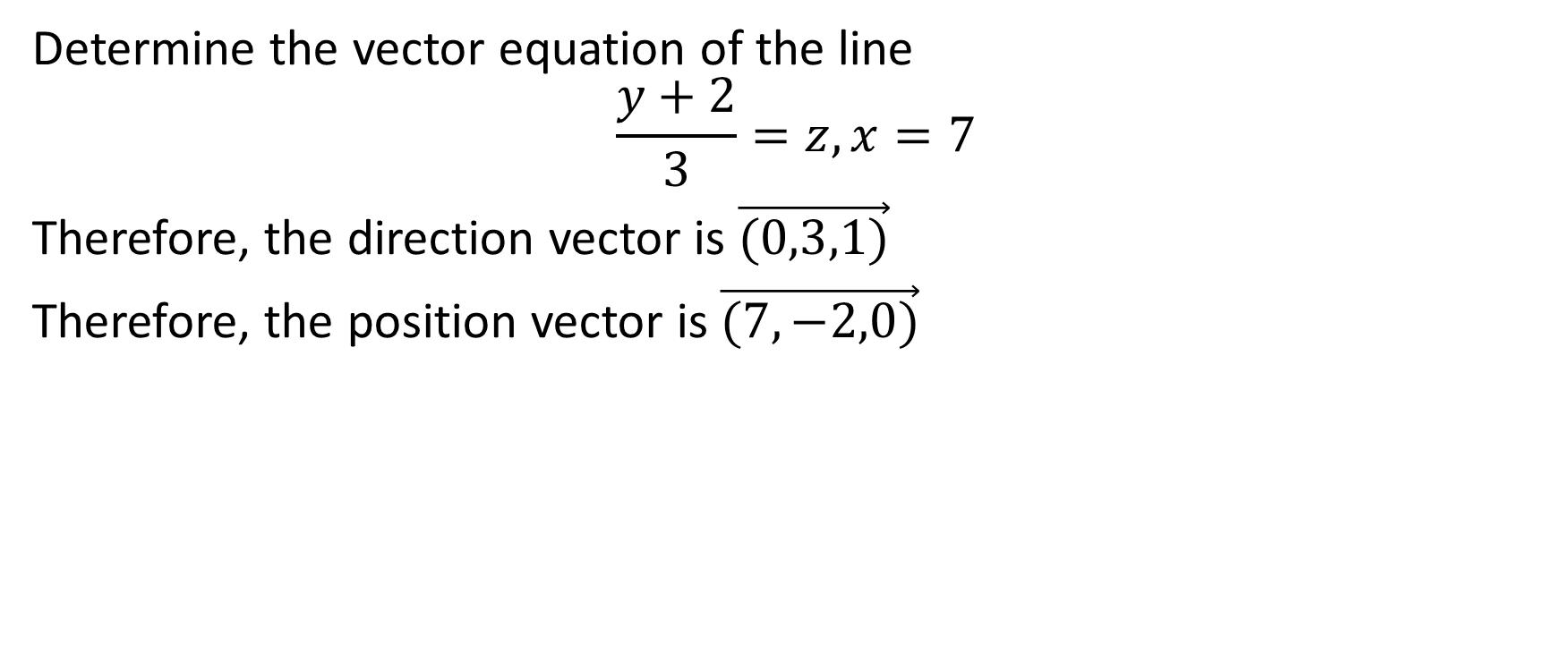
Determine the vector equation of the line
$$\frac{y+2}{3}=z,x=7$$
Therefore, the direction vector is $\vec{(0,3,1)}$
Therefore, the position vector is $\vec{(7,−2,0)}$

Slide 48
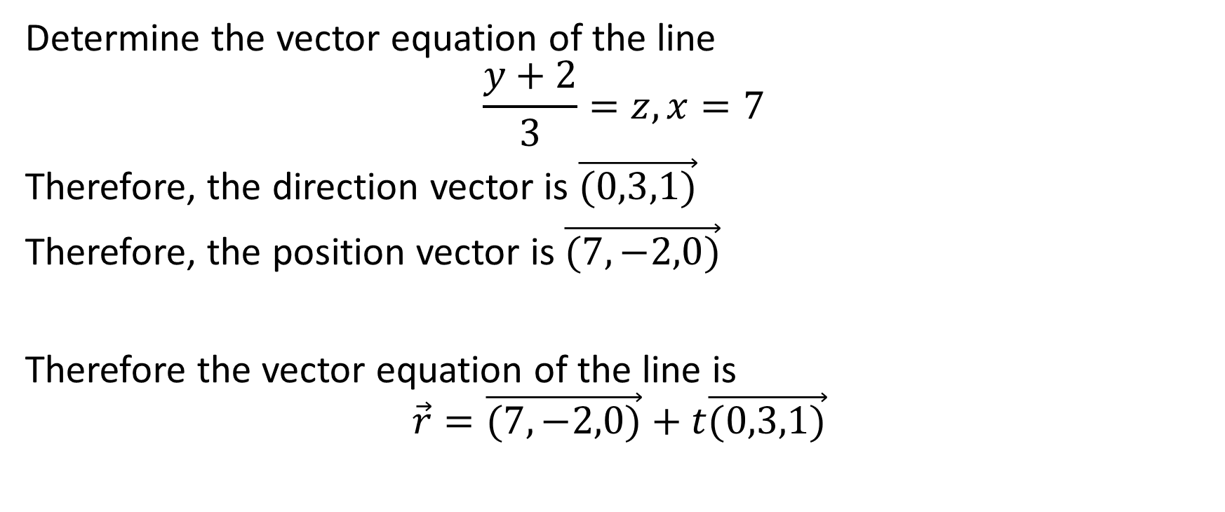
Determine the vector equation of the line
$$\frac{y+2}{3}=z,x=7$$
Therefore, the direction vector is $\vec{(0,3,1)}$
Therefore, the position vector is $\vec{(7,−2,0)}$
Therefore the vector equation of the line is
$$\vec{r}=\vec{(7,−2,0)}+t\vec{(0,3,1)}$$

Slide 49

Example
There is a point A on $L_{1}:\vec{r}=\vec{(4,2,−1)}+s\vec{(1,−1,−2)}$ and a point B on $L_{2}:\vec{r}=\vec{(0,1,3)}+t\vec{(2,1,1)}$ such that the distance between the two lines is a minimum. Determine the coordinates of A and B.

Slide 50
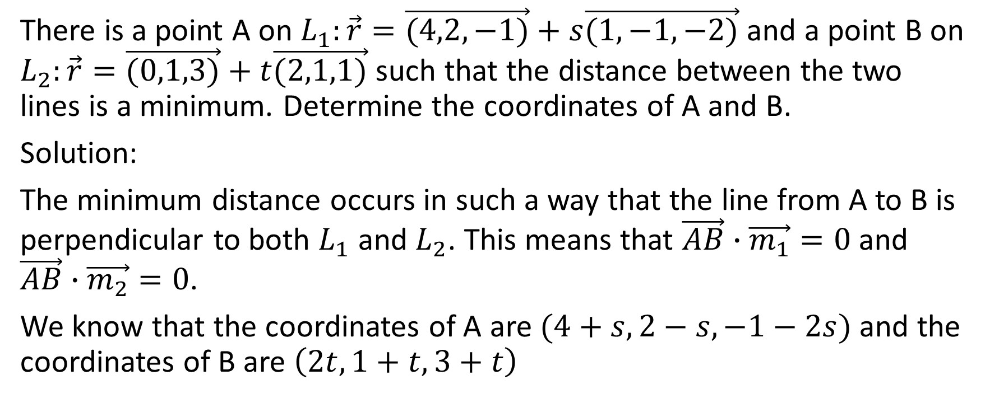
There is a point A on $L_{1}:\vec{r}=\vec{(4,2,−1)}+s\vec{(1,−1,−2)}$ and a point B on $L_{2}:\vec{r}=\vec{(0,1,3)}+t\vec{(2,1,1)}$ such that the distance between the two lines is a minimum. Determine the coordinates of A and B.
Solution:
The minimum distance occurs in such a way that the line from A to B is perpendicular to both $L_{1}$ and $L_{2}$. This means that $\vec{AB}∙\vec{m_{1}}=0$ and $\vec{AB}∙\vec{m_{2}}=0$.
We know that the coordinates of A are $(4+s,2−s,−1−2s)$ and the coordinates of B are $\left(2t,1+t,3+t\right)$

Slide 51
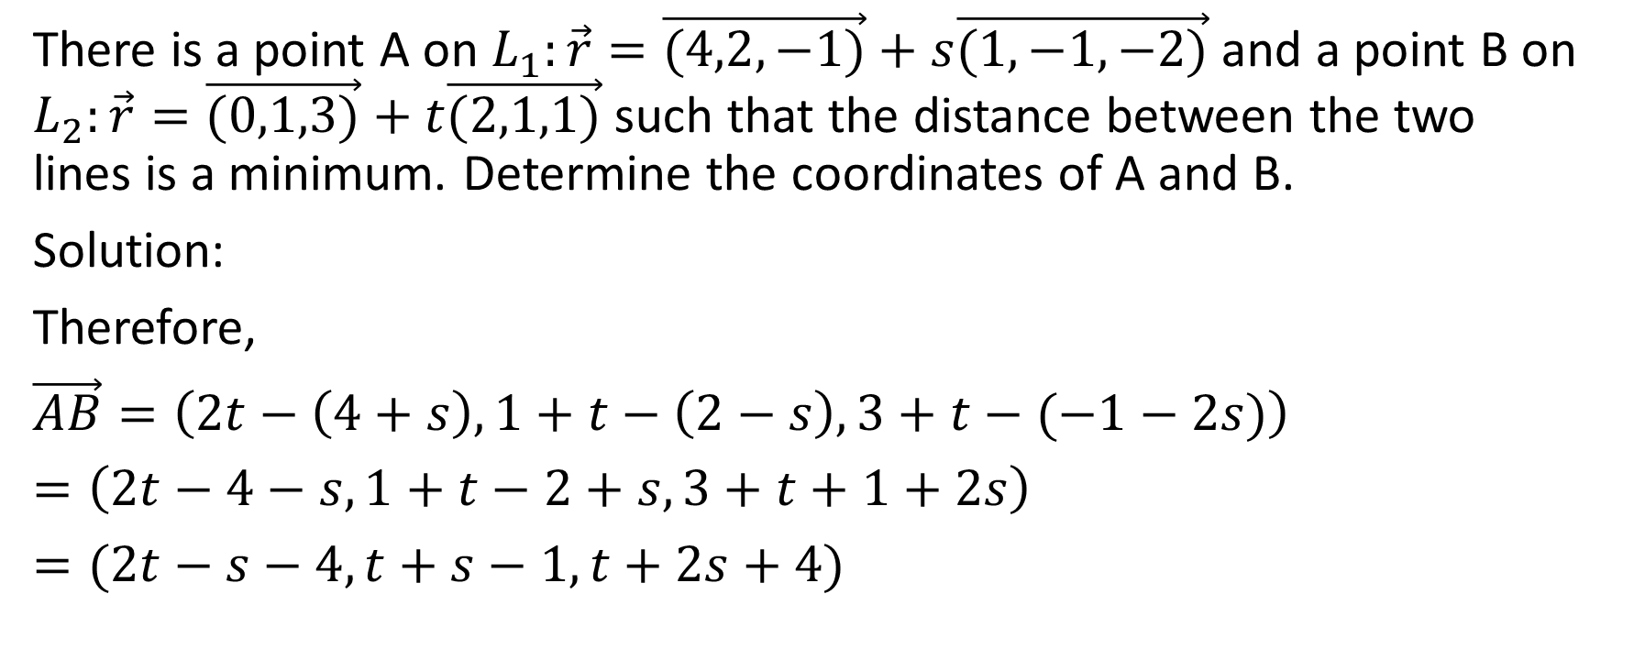
There is a point A on $L_{1}:\vec{r}=\vec{(4,2,−1)}+s\vec{(1,−1,−2)}$ and a point B on $L_{2}:\vec{r}=\vec{(0,1,3)}+t\vec{(2,1,1)}$ such that the distance between the two lines is a minimum. Determine the coordinates of A and B.
Solution:
Therefore,
$\vec{AB}=\left(2t−\left(4+s\right),1+t−\left(2−s\right),3+t−(−1−2s)\right)$
$=\left(2t−4−s,1+t−2+s,3+t+1+2s\right)$
$=(2t−s−4,t+s−1,t+2s+4)$

Slide 52
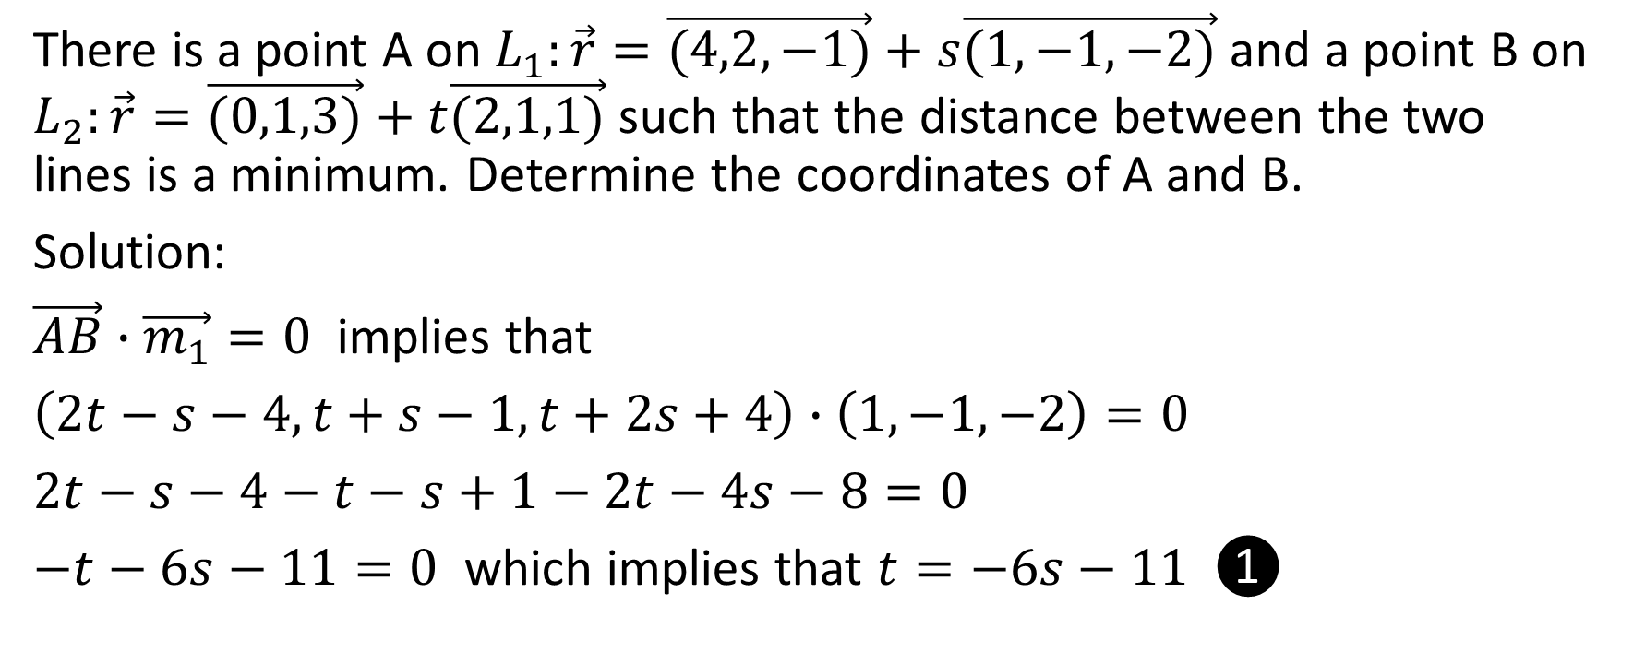
There is a point A on $L_{1}:\vec{r}=\vec{(4,2,−1)}+s\vec{(1,−1,−2)}$ and a point B on $L_{2}:\vec{r}=\vec{(0,1,3)}+t\vec{(2,1,1)}$ such that the distance between the two lines is a minimum. Determine the coordinates of A and B.
Solution:
$\vec{AB}∙\vec{m_{1}}=0$ implies that
$2t−s−4−t−s+1−2t−4s−8=0$
$−t−6s−11=0$ which implies that $t=−6s−11$ ❶

Slide 53
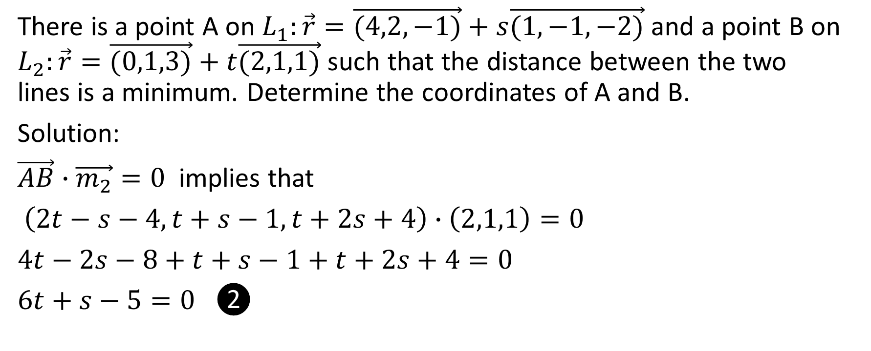
There is a point A on $L_{1}:\vec{r}=\vec{(4,2,−1)}+s\vec{(1,−1,−2)}$ and a point B on $L_{2}:\vec{r}=\vec{(0,1,3)}+t\vec{(2,1,1)}$ such that the distance between the two lines is a minimum. Determine the coordinates of A and B.
Solution:
$\vec{AB}∙\vec{m_{2}}=0$ implies that
$\left(2t−s−4,t+s−1,t+2s+4\right)∙\left(2,1,1\right)=0$
$4t−2s−8+t+s−1+t+2s+4=0$
$6t+s−5=0$ ❷

Slide 54
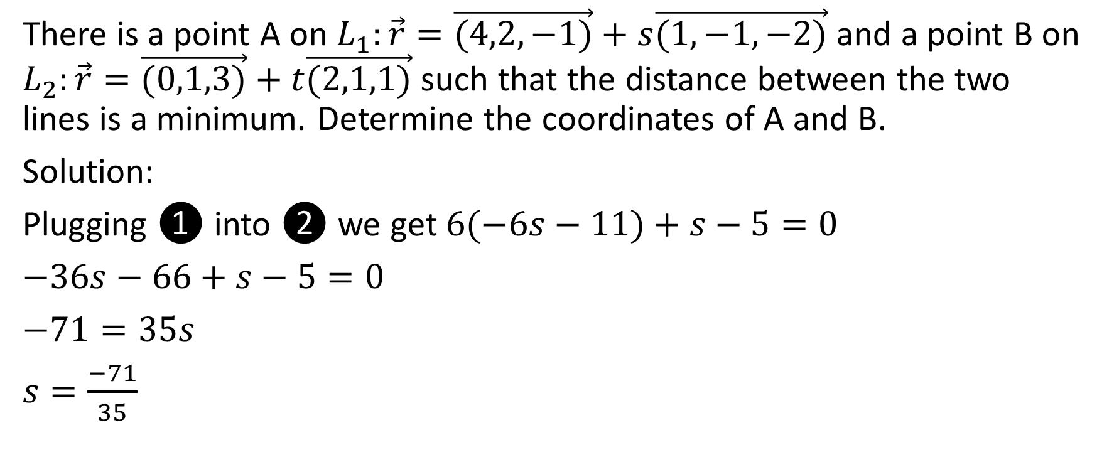
There is a point A on $L_{1}:\vec{r}=\vec{(4,2,−1)}+s\vec{(1,−1,−2)}$ and a point B on $L_{2}:\vec{r}=\vec{(0,1,3)}+t\vec{(2,1,1)}$ such that the distance between the two lines is a minimum. Determine the coordinates of A and B.
Solution:
Plugging ❶ into ❷ we get $6(−6s−11)+s−5=0$
$−36s−66+s−5=0$
$−71=35s$
$s=\frac{−71}{35}$

Slide 55
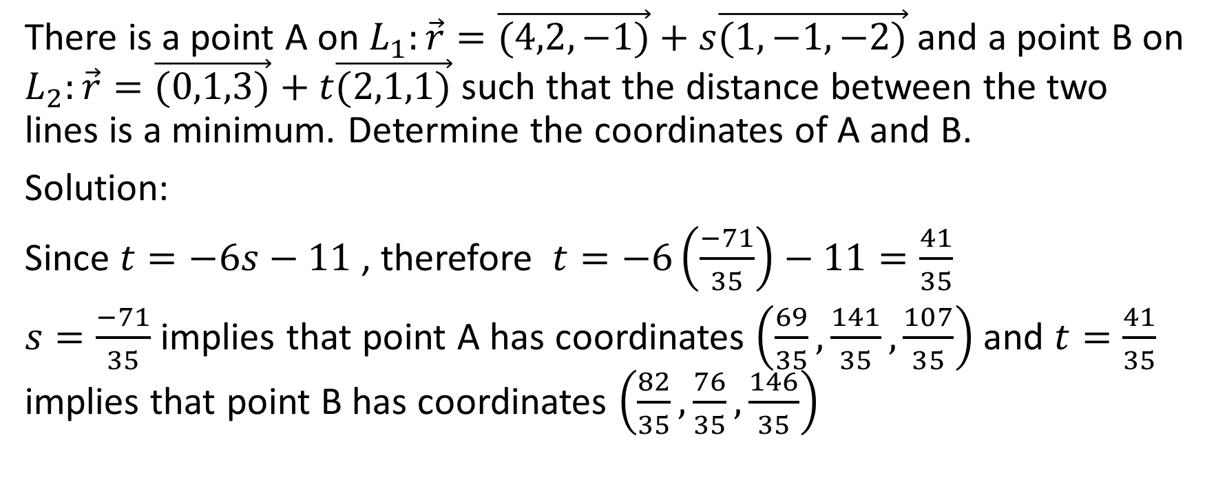
There is a point A on $L_{1}:\vec{r}=\vec{(4,2,−1)}+s\vec{(1,−1,−2)}$ and a point B on $L_{2}:\vec{r}=\vec{(0,1,3)}+t\vec{(2,1,1)}$ such that the distance between the two lines is a minimum. Determine the coordinates of A and B.
Solution:
Since $t=−6s−11$ , therefore $t=−6\left(\frac{−71}{35}\right)−11=\frac{41}{35}$
$s=\frac{−71}{35}$ implies that point A has coordinates $\left(\frac{69}{35},\frac{141}{35},\frac{107}{35}\right)$ and $t=\frac{41}{35}$ implies that point B has coordinates $\left(\frac{82}{35},\frac{76}{35},\frac{146}{35}\right)$

